Slide 1
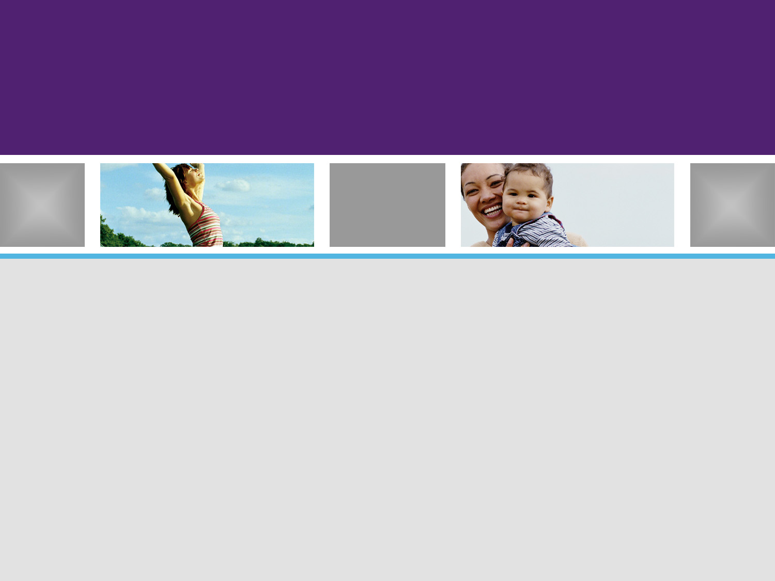
SaaS Planning Guide
For Business Liaisons and IT Leaders

Slide 2

Preface
SaaS (Software as a Service) is not your father’s ASP model. When done properly, it is a service offering that organizations can leverage in a progressive manner. SaaS models typically consist of the following:
  Built on a solid integration platform
  Built on an open data model
  Built with patterned business processes and services
  Built with a flexible presentation layer

Slide 3
What is Saas ?
“Software deployed as a hosted service and accessed over the internet”
“IT as a Utility”
First deployed in 1998-1999

Slide 4
How is it deployed ?
Types of deployments
  Micro Services (reusable services and/or intelligent agents, that are integrated into an organization’s application: examples = Google apps, Tax prep)
  Function points (mail, social media, reservations)
  Service Patterns (infrastructure hosting = cloud, disaster recovery, network services, ERP)

Slide 5
Maturity model is still evolving…
Ad-Hoc or custom setup
  Each customer has their own version of code using a separate hardware instance (zero sharing)
Configurable (one customer per app server)
  Does not require customization. Each customer runs their own instance of software with limited hardware sharing
Configurable (multiple customers per app server)
  Also does not require customization. All customers using a single instance of software (code) running on a shared hardware platform. Solutions are more scalable, and more stable.

Slide 6
Why should I consider SaaS ?
Paradigm shift from software/products to services
Reliability
  the Web is reliable and redundant
Lower upfront costs
Lower software maintenance
Educate hardware maintenance

